Slide 1


<Name>
<Date>

Slide 2

Outline
Executive Summary
Introduction
Methodology
Results
Conclusion
Appendix

Slide 3
Executive Summary
Summary of the methodologies that were used for data analysis:
Data Collection using SpaceX API, WebScraping and SQL Queries
Exploratory Data Analysis(EDA); data wrangling and visualization, interactive visual analytics
Experimentations with multiple Machine Learning Algorithms for predictions
Summary of all results
Data were collected from valuable and official sources
EDA allowed to identify which data features are a best fit to predict the launches success
Machine Learning Algorithms experimentations revealed which model would be the best in predicting launches success based on the collected data

Slide 4
Introduction
The objective of the analysis is to evaluate if the company Space Y could compete with Space X.
We try to find answers:
To estimate the cost of launches, predict successful landings of the first stage rockets and the best places to make launches.

Slide 5

Section 1

Slide 6
Methodology
Executive Summary
Data collection methodology:
SpaceX API, multiple endpoints were used to collect data from https://api.spacexdata.com/v4/
/rockets/, /launchpads/, /payloads/, /cores/, /launches/past
WebScraping from:
https://en.wikipedia.org/w/index.php?title=List_of_Falcon_9_and_Falcon_Heavy_launches&oldid=1027686922
Perform data wrangling
Data was analyzed to find patterns and determine the label for successful and unsuccessful landings.

Slide 7
Methodology
Executive Summary
Perform exploratory data analysis (EDA) using visualization and SQL
Perform interactive visual analytics using Folium and Plotly Dash
Perform predictive analysis using classification models
Collected data were used to evaluate the accuracy of different models. The data was split into training and testing sets and Machine Learning Algorithms were run with different parameters, trying to find the best hyperparameters for every models.

Slide 8
Data Collection
SpaceX API:
https://api.spacexdata.com/v4/rockets/
https://api.spacexdata.com/v4/launchpads/
https://api.spacexdata.com/v4/payloads/
https://api.spacexdata.com/v4/cores/
https://api.spacexdata.com/v4/launches/past"
WebScraping:
https://en.wikipedia.org/w/index.php?title=List_of_Falcon_9_and_Falcon_Heavy_launches&oldid=1027686922

Slide 9
Data Collection – SpaceX API
SpaceX API
Request data from endpoints
Response
Data is returned in a JSON format as array of objects
Prepare data
Filter necessary data to keep only the one related to Falcon 9 launches
Deal with missing values
SpaceX exposes public API that can be used to obtain data. The API Documentation can be found at: https://docs.spacexdata.com/
GitHub URL of the SpaceX API calls notebook: SpaceX Data Collection API Notebook

Slide 10
Data Collection - Scraping
SpaceX WikiPedia
Request data from WikiPedia using WebScraping techniques
Response
Extract relevant tables and columns/variables names and values
Prepare data
Prepare data, filter necessary values and create DataFrame
SpaceX launches data were obtained from wikipedia: SpaceX Falcon 9 Launches
GitHub URL of the SpaceX WebScraping notebook: SpaceX WebScraping Notebook

Slide 11
Data Wrangling
Some EDA was done to find pattern in the data and determine what would be the best features to uses for training and testing purposes.
Preliminary evaluation of data and ; null values, object types, launch sites, become familiar with the different kind of orbit types.
GitHub URL of the Data Wrangling notebook: Data Wrangling Notebook
EDA
Exploratory Data Analysis of SpaceX data and become familiar with the available information
Summary
Launches success rate, orbit types
Prepare data
Creation of ‘Class’ outcome label based on the available outcome information

Slide 12
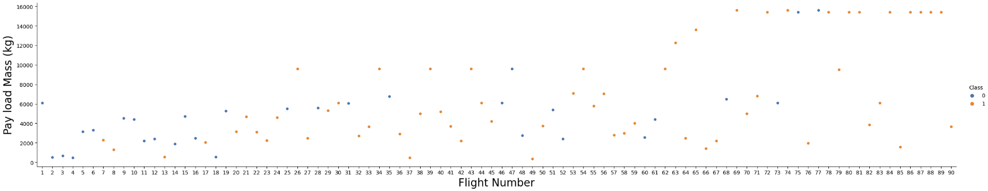
EDA with Data Visualization
Different types of charts were used to find relationship/correlation between the different variables; Flight Number VS Pay load Mass(kg), Flight Number VS Launch Site, Launch Site VS Payload Mass, Orbit VS Success Rate, Flight Number VS Orbit, Payload Mass VS Orbit,
GitHub URL of the EDA Data Visualisation notebook: EDA Data Visualisation Notebook
Exemple:

Slide 13
EDA with SQL
After creating a locale SQLite DB for EDA purpose, these queries were executed to find insight:
Display the names of the unique launch sites in the space mission
Display 5 records where launch sites begin with the string 'CCA'
Display the total payload mass carried by boosters launched by NASA (CRS)
Display average payload mass carried by booster version F9 v1.1
List the date when the first succesful landing outcome in ground pad was acheived.
List the names of the boosters which have success in drone ship and have payload mass greater than 4000 but less than 6000
List the total number of successful and failure mission outcomes
List the names of the booster_versions which have carried the maximum payload mass. Use a subquery
List the records which will display the month names, failure landing_outcomes in drone ship ,booster versions, launch_site for the months in year 2015.
Rank the count of landing outcomes (such as Failure (drone ship) or Success (ground pad)) between the date 2010-06-04 and 2017-03-20, in descending order.
GitHub URL of the EDA with SQL notebook: EDA with SQL

Slide 14
Build an Interactive Map with Folium
A map was build, using Folium, to give a visual geospatial representation of the data. Different types of objects were used:
Markers: represent a point on a map with specific latitude/longitude. In our case, point represents launch sites.
Marker Clusters: Group of point on a map
Circles: an “circled” area that is highlighted around specific geo-coordinates.
Lines: define a line between two coordinates, in our case it was used to show the distance between two points.
GitHub URL of the Interactive Map with Folium notebook: Launch Site Location

Slide 15
Build a Dashboard with Plotly Dash
Two types of interactive graphs were used to visualize the data.
Pie: success launches by site
Scatter with range slider: to see the successful launches by site based on payload mass and booster version.
The combination of these two chart and slider allowed us to quickly find the relation between payload, launch site and booster version. That can also gives hint on the best place to launch based on these characteristics.
GitHub URL of the Dashboard with Plotly Dash Python file: SpaceX Dash

Slide 16
Predictive Analysis (Classification)
Four(4) Classification Models were used to compare their performances; Logistic Regression, Support Vector Machine(SVM), Decision Tree and K-Nearest Neighbors(KNN).
The four models were trained and tested on the same set of training and testing data.
GitHub URL of the Predictive Analysis notebook: ML Prediction
Data
Preparation of the data, standardization
Testing
Testing of the different Machine Learning Algorithms
Results
Comparaison of the results obtained by the different models being evaluated
Creation of the training/testing sets

Slide 17
Results
EDA results
There is 4 x different launch sites used by SpaceX.
The payload mass sum of boosters launched by NASA (CRS) is 45596 kg.
Average payload mass of F9 v1.1 booster is 2928.4 kg.
The first successful ground pad launch happened in 2015-12-22.
The boosters which have success in drone ship and have a payload mass between 4000 and 6000 kg are: F9 FT B1022, F9 FT B1026, F9 FT B1021.2, F9 FT B1031.2.
~99% of mission outcomes were successful, with 100 x success and 1 x failure.
Booster version that carried the maximum payload mass of 15600 kg are: F9 B5 B1048.4, F9 B5 B1049.4, F9 B5 B1051.3, F9 B5 B1056.4, F9 B5 B1048.5, F9 B5 B1051.4, F9 B5 B1049.5, F9 B5 B1060.2, F9 B5 B1058.3, F9 B5 B1051.6, F9 B5 B1060.3, F9 B5 B1049.7.
There were apparently 2 x failures in the year 2015 with booster versions F9 v1.1 B1012 and F9 v1.1 B1015.
Outcomes are more successful over time.

Slide 18
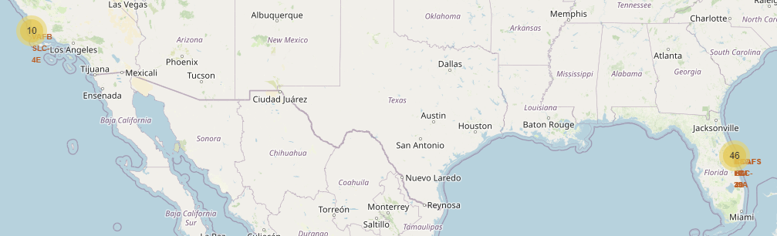
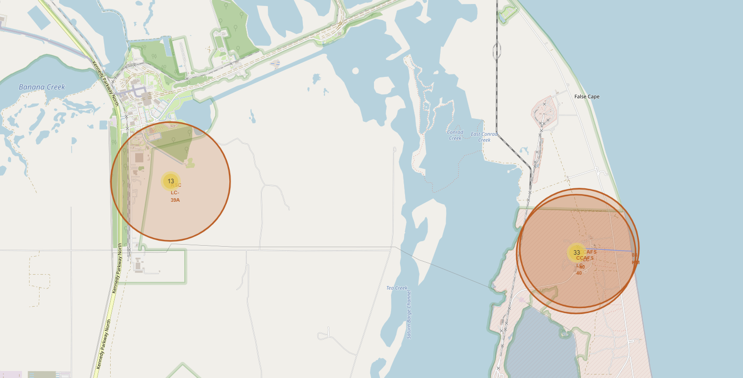
Results
Interactive analytics
Most of the launches were done on the east coast and from a distance of approximately 90 km from the sea. It could be considered as a safe place.

Slide 19
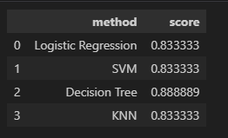
Results
Predictive analysis results
Experimentations with different Machine Learning Algorithms showed that Decision Tree Classification Model is the best in predicting successful landings with accuracy over 88%.

Slide 20

Section 2

Slide 21
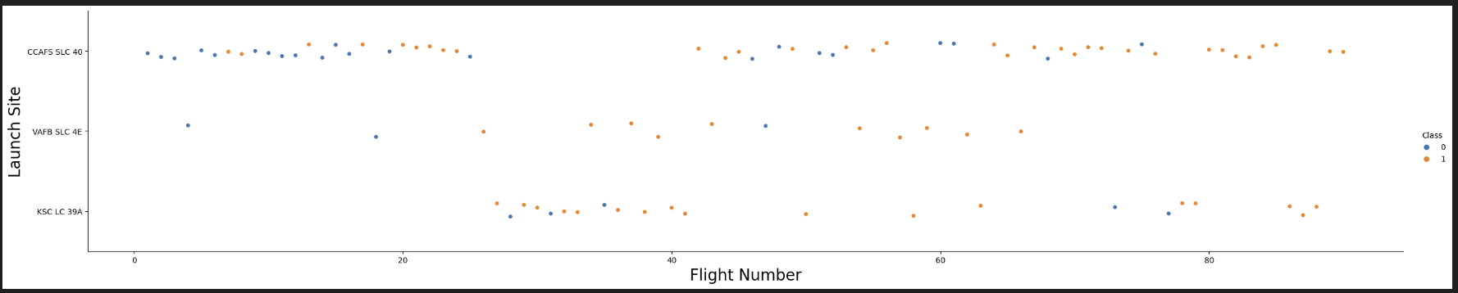
Flight Number vs. Launch Site
Based on the graphic above, it looks like the site CCAFS SLC 40 is the best locations, since most of the recent launches were successful.
Also, the plot seems to confirm that, when comparing the recent launches of all sites, the global success was getting better over time.

Slide 22
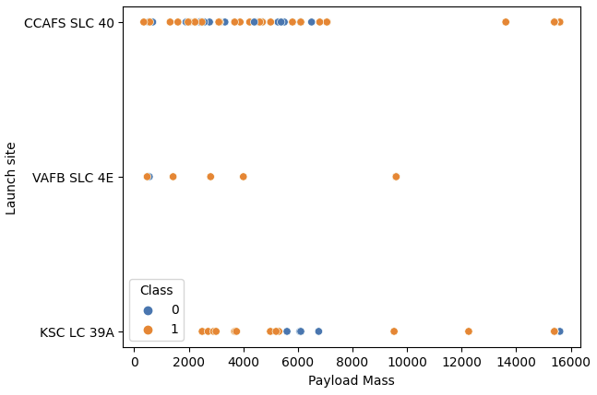
Payload vs. Launch Site
The graphic show that launches with heavier payload have better success rate; over 9000 kg ar mostly successful.
Most launches under 8000 kg were made on the location CCAFS SLC 40.
CCAFS SLC 40 and KSC LC39A seems to be the only sites with launches over 10000 kg.

Slide 23
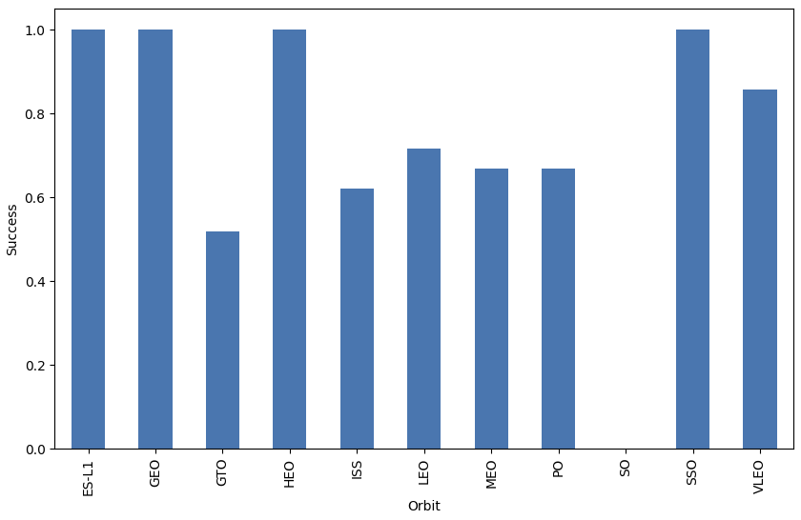
Success Rate vs. Orbit Type
Orbits with the best success rate, of 100%, are: EL-L1, GEO, HEO, SSO.
As for the other orbits:
VLEO: ~82%
LEO: ~70%
MEO, PO: ~65%
ISS: ~60%
GTO: ~50%

Slide 24
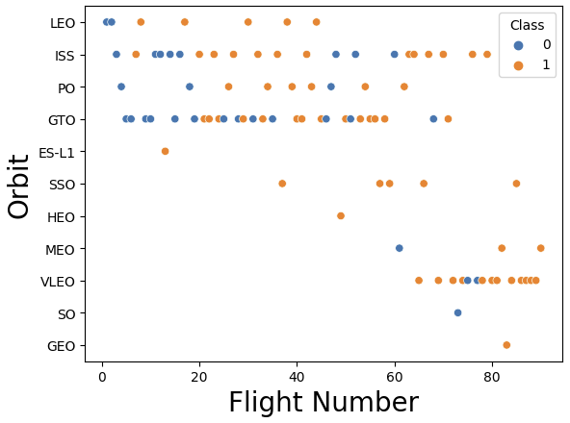
Flight Number vs. Orbit Type
Orbits SSO, HEO, MEO SO and GEO are not as frequent as the others, where ISS and GTO are most used and the use of VLEO seems to increase over time.

Slide 25
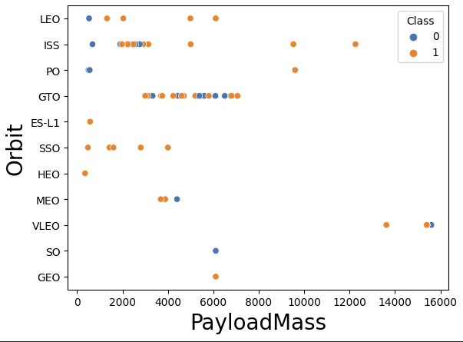
Payload vs. Orbit Type
There do not seem to be a correlation between Payload Mass and success rate to Orbits.

Slide 26
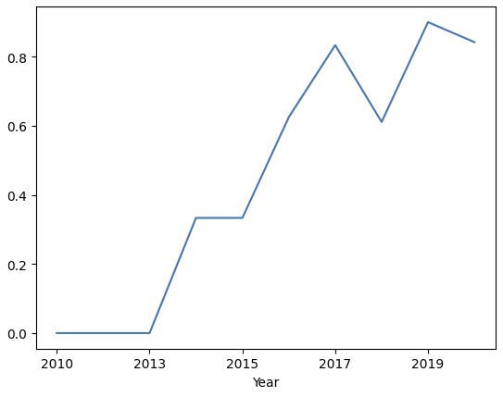
Launch Success Yearly Trend
Success rate keep getting better over time, since 2013, with a small drop in 2018.
The better outcomes could be due to adjustments in launches calculation algorithms.

Slide 27
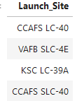
All Launch Site Names
Based on the extracted data, there is 4 x launch sites.

Slide 28
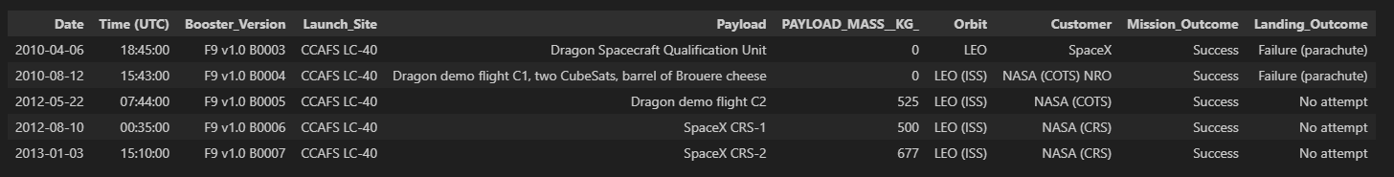
Launch Site Names Begin with 'CCA'
Sample of 5 x launch sites where the name begins with ‘CCA’

Slide 29
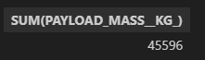
Total Payload Mass
Sum of the total payload carried by boosters from NASA, calculated using the SQL SUM Method.

Slide 30
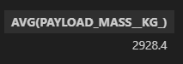
Average Payload Mass by F9 v1.1
Average payload carried by booster version F9 v1.1, calculated using the SQL AVG Method.

Slide 31
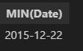
First Successful Ground Landing Date
Date of the first successful landing outcome on ground pad. The results were filtered out to find the minimum date value.

Slide 32
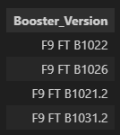
Successful Drone Ship Landing with Payload between 4000 and 6000
Names of boosters which have successfully landed on drone ship and had payload mass greater than 4000 but less than 6000. Filtered out by finding the unique values.

Slide 33
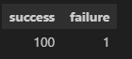
Total Number of Successful and Failure Mission Outcomes
Total number of successful and failure mission outcomes, calculated by grouping the mission outcomes.

Slide 34
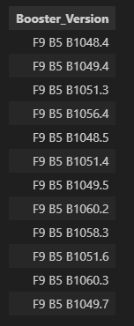
Boosters Carried Maximum Payload
Names of the booster which have carried the maximum payload mass. Was filtered out on the value of 15600 kg.

Slide 35
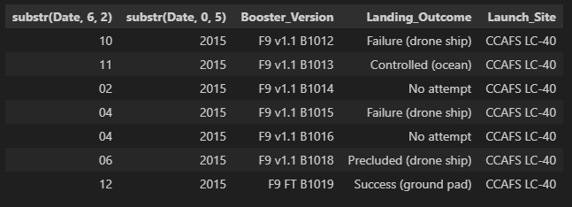
2015 Launch Records
Failed landing_outcomes in drone ship, their booster versions, and launch site names for in year 2015.

Slide 36
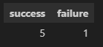
Rank Landing Outcomes Between 2010-06-04 and 2017-03-20
Rank the count of landing outcomes (such as Failure (drone ship) or Success (ground pad)) between the date 2010-06-04 and 2017-03-20, in descending order

Slide 37

Section 3

Slide 38
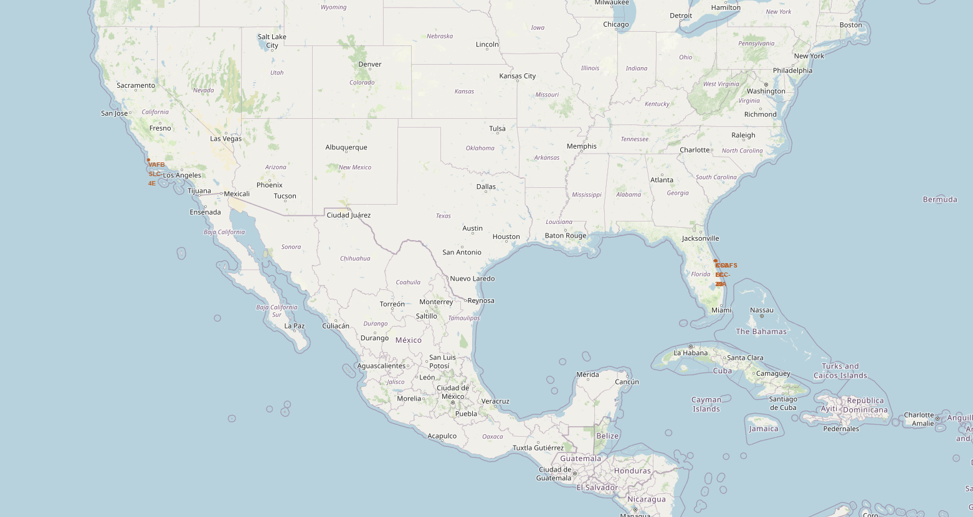
All launch locations
All launch sites looks to have been chosen near the coastline, potentially for safety reasons.

Slide 39
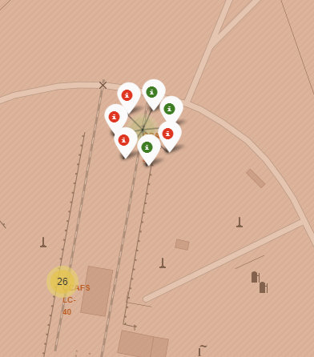
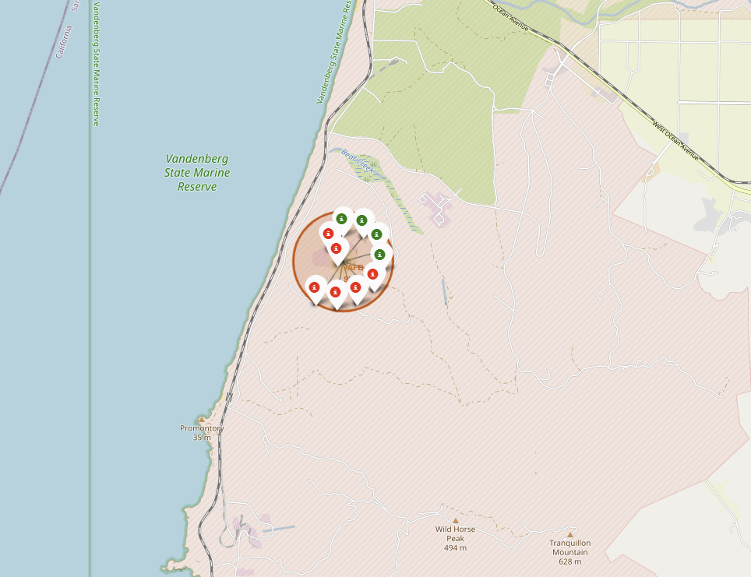
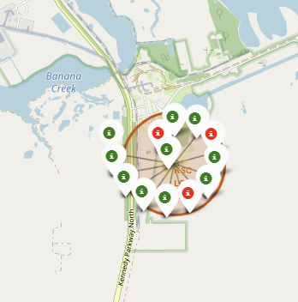
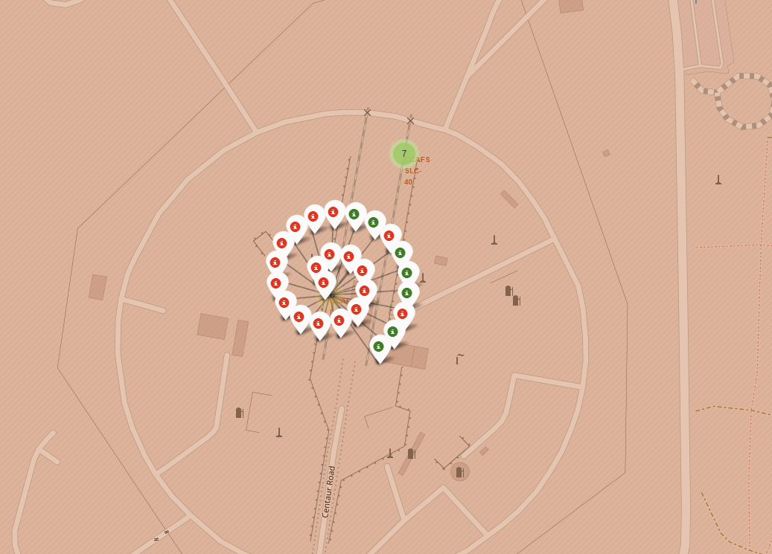
Launch outcomes by locations
All launches outcomes by sites, where green markers indicate success and red indicate failure.

Slide 40
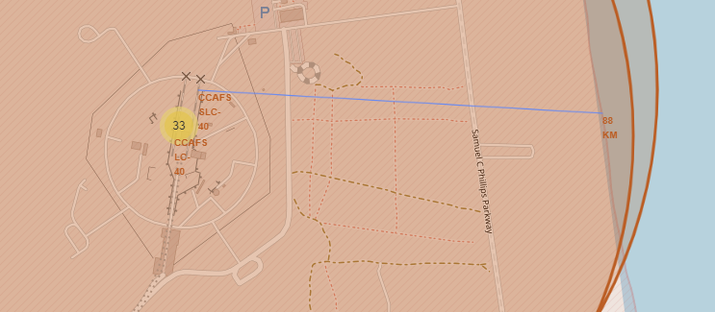
Launch locations Safety
Most sites look to be within 90 km of the coast line and far from inhabited areas.

Slide 41

Section 4

Slide 42
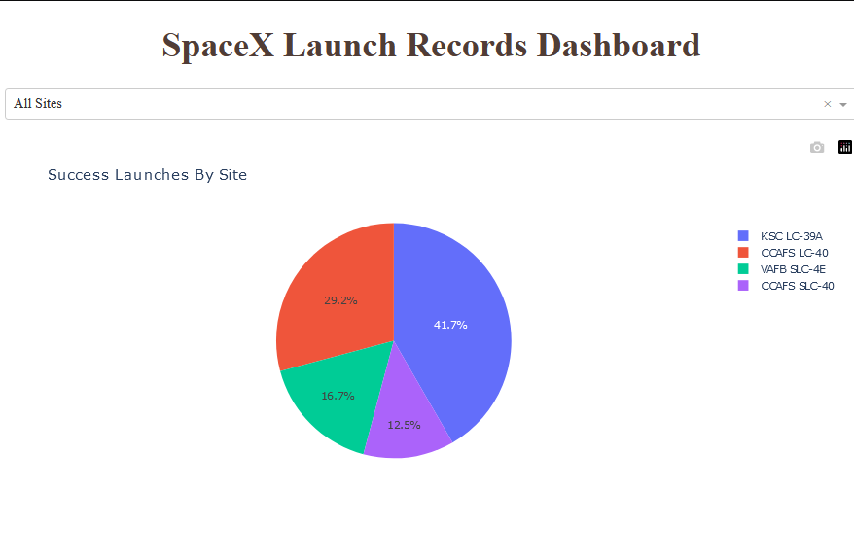
Successful launches by Sites
The choice of launch location seems to have an impact on the success rate.

Slide 43
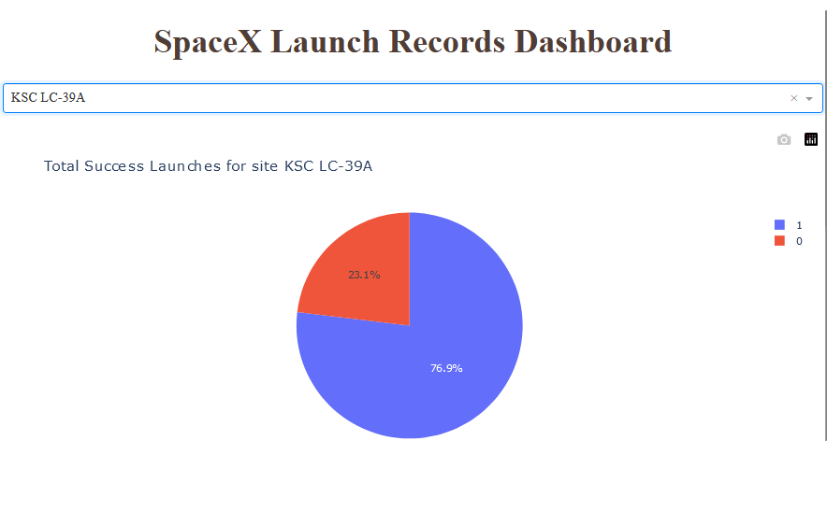
Success ratio for site KSC KC-39A
Site KSC KC-39A has 76.9% success rate.

Slide 44
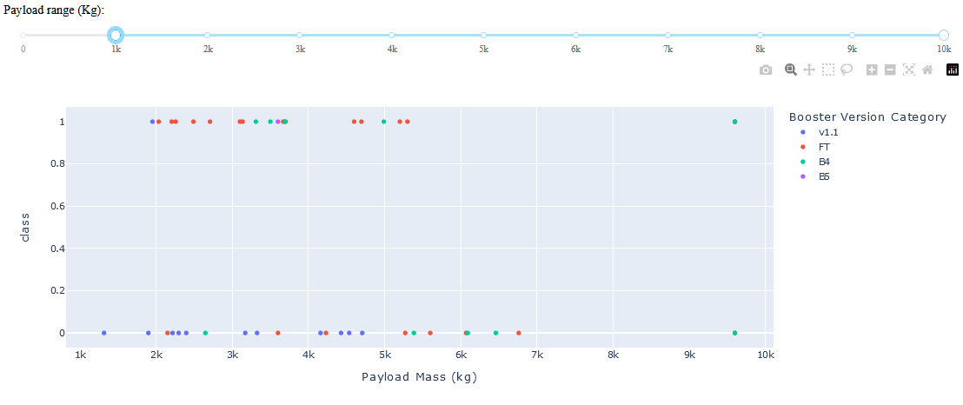
Payload Mass (kg) VS Launch Outcomes(class)
Payload Mass under 6000 kg, combined with FT booster version, is the most successful combination. Also, there is not a lot of data to make a an estimate on Payload Mass over 6000 kg.

Slide 45

Section 5

Slide 46
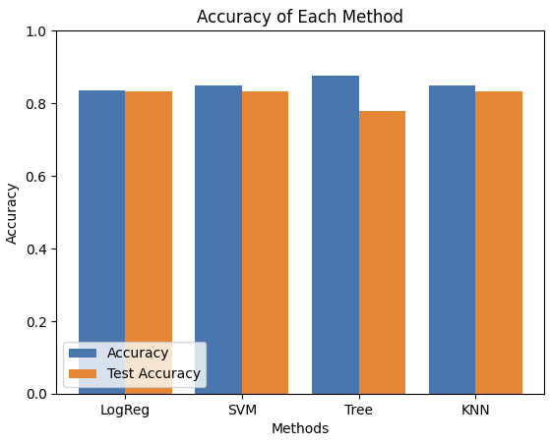
Classification Accuracy
Four classification models were evaluated.
The most successful model in predicting outcome is the Decision Tree Algorithm with an accuracy over 87%.

Slide 47
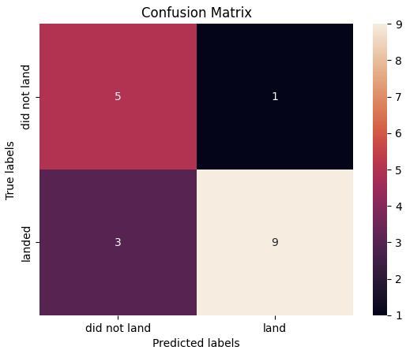
Confusion Matrix
The confusion matrix of the Decision Tree Classification Model, show True/False Positive and True/False Negative.

Slide 48
Conclusions
Different sources of data were evaluated, from API extracted information to WebScraping, revealing insights
Decision Tree Classification Model proved to be an effective choice for prediction
The site with the most successful launches is KSC LC-39A
While the mission outcomes improved over time, there is still room for improvement and that could depend on the evolution of rockets and other factors

Slide 49
Appendix
Folium maps are not visible on GitHub

Slide 50


